Slide 1
Disease Classification from Symptoms Description
Mentored By,
Dr. Divya J
Presented By,
PAVITHRA G R (312322205123)
LINDA CHRISTINA F (312322205091)

Slide 2
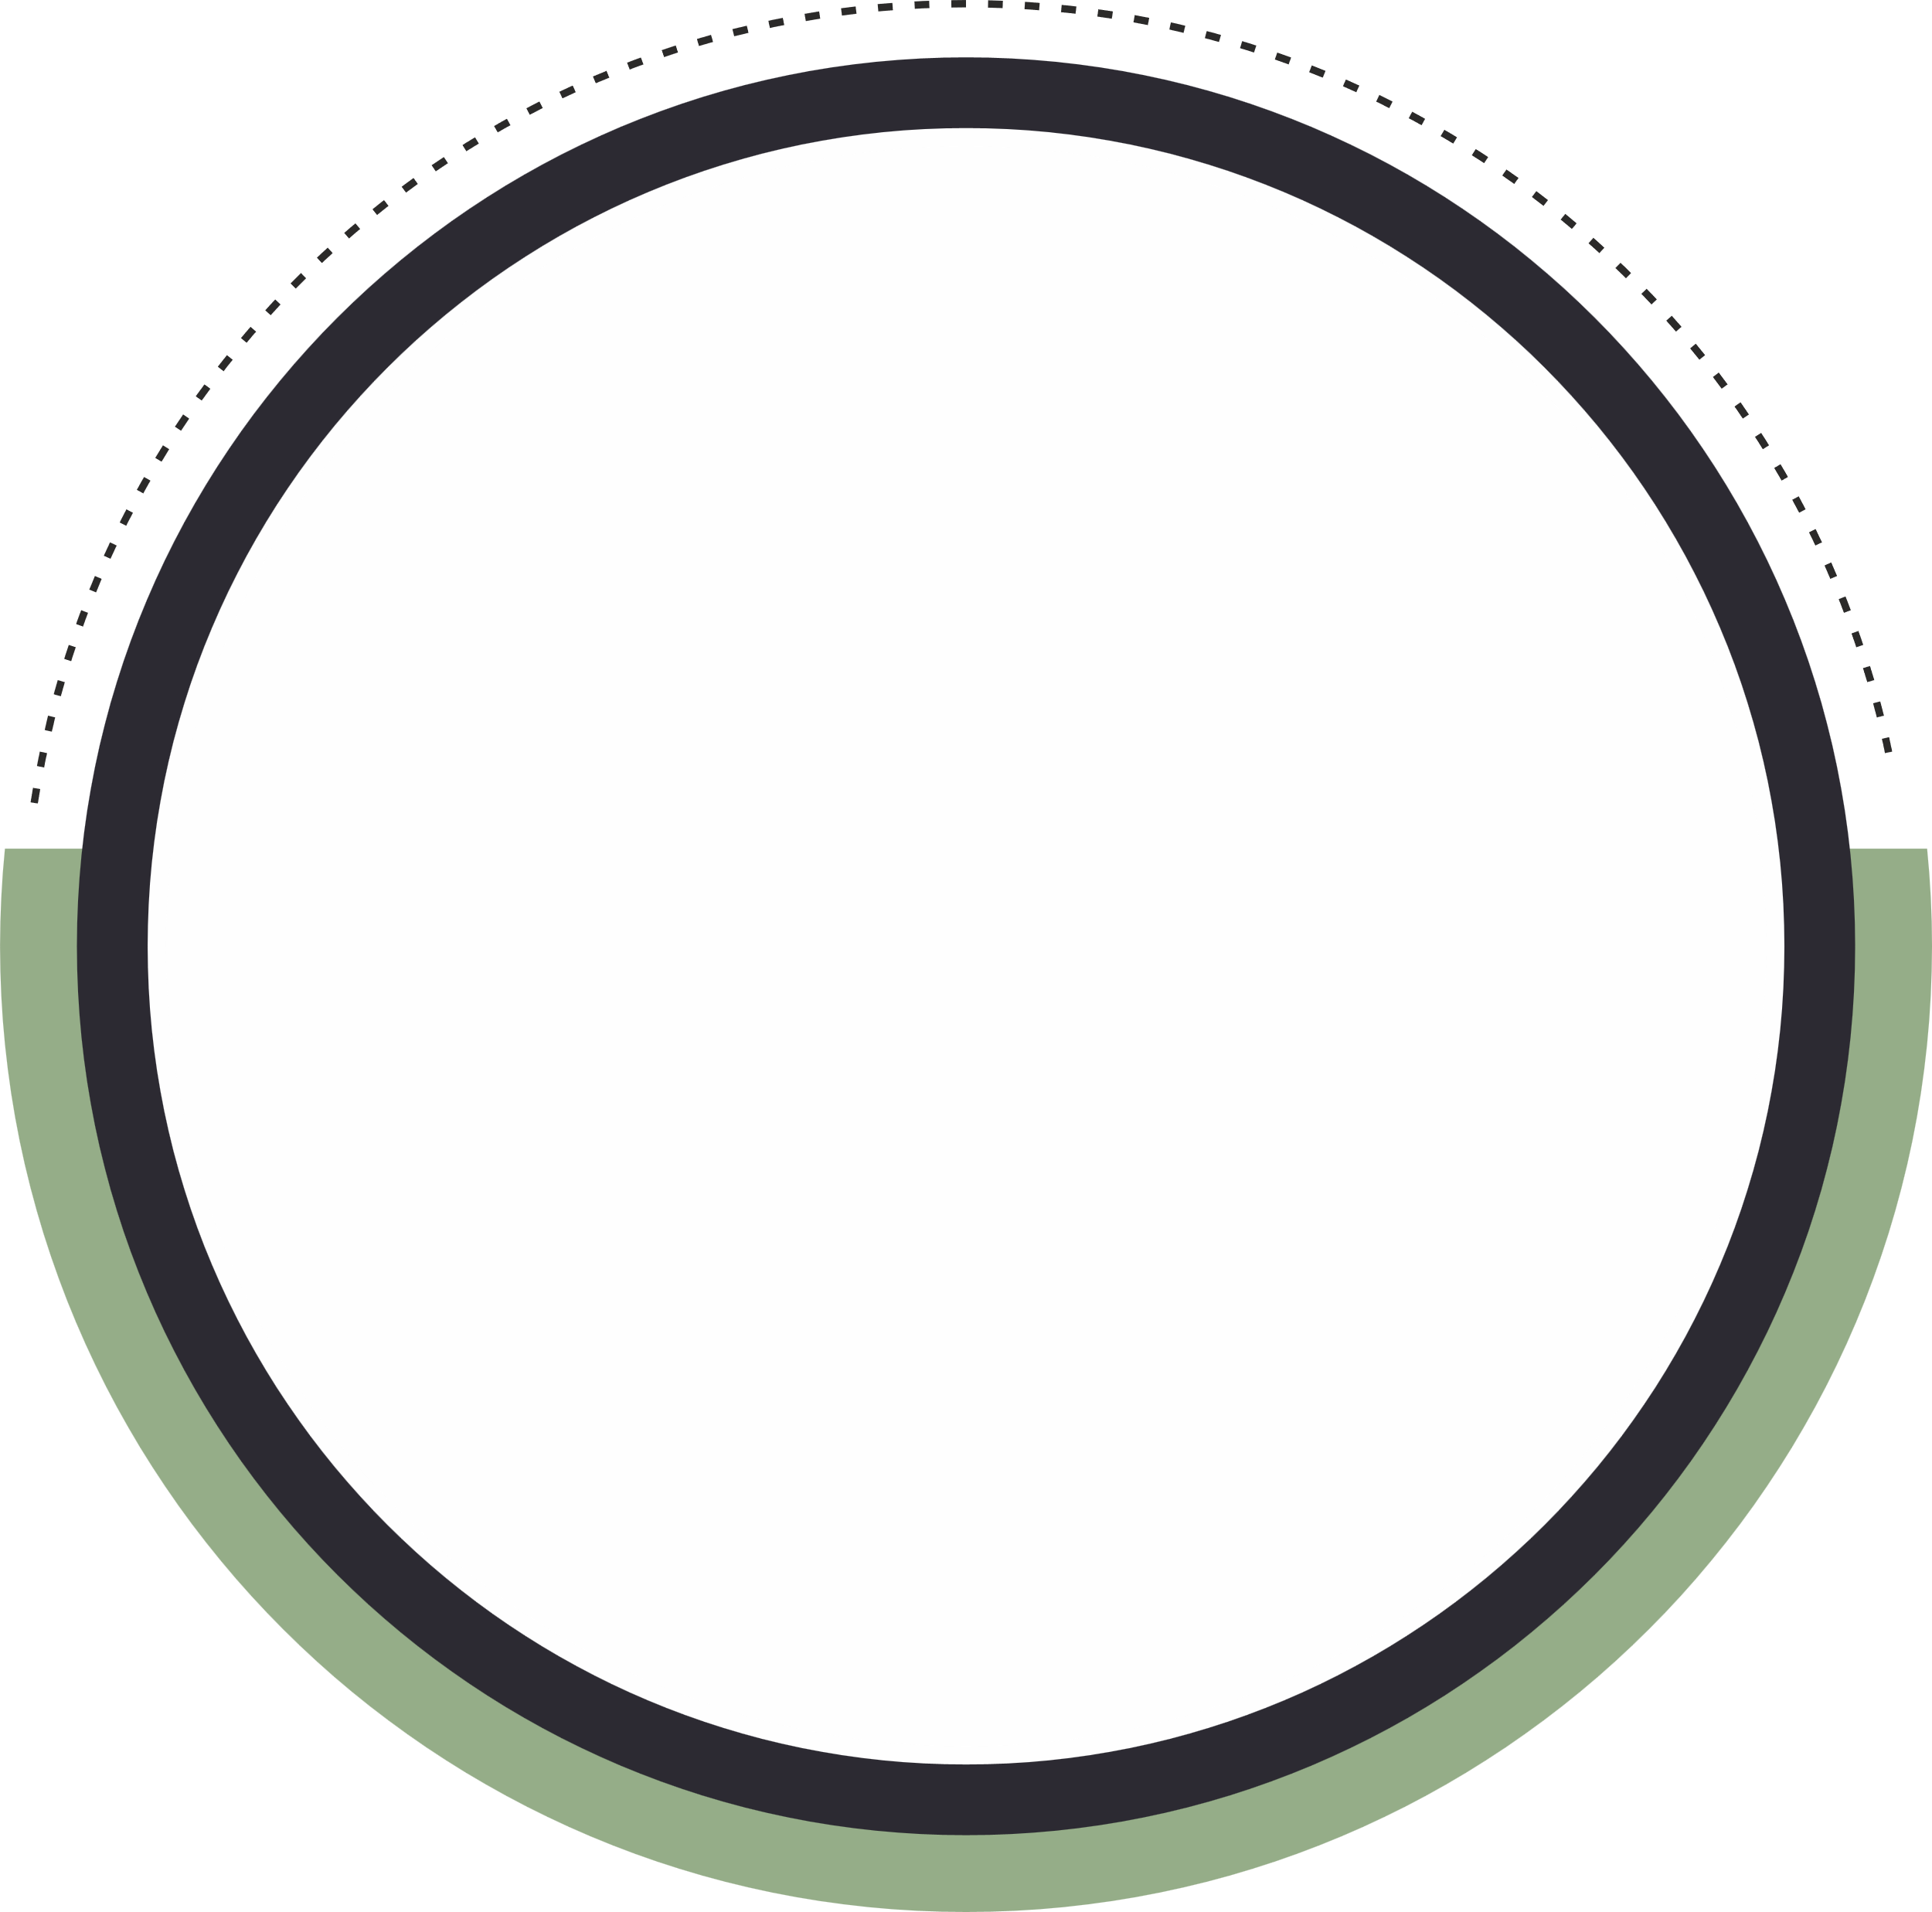





PROBLEM OVERVIEW
Vision Analysis
Strategic Objectives
To empower individuals with early and accurate disease predictions based on symptoms, improving healthcare accessibility and timely interventions globally.
To create a scalable, accurate disease prediction system, improving early detection, accessibility, and supporting healthcare professionals with timely, data-driven insights.
Many individuals face difficulties in accessing
timely and accurate medical diagnoses, leading to late detection of diseases, often due to reliance on self-diagnosis or overcrowded healthcare systems.
Mission Analysis
Strategy Evaluation and Selection
To develop an accessible and efficient disease prediction system that uses advanced techniques like TF-IDF and KNN to provide early, reliable diagnoses based on user-reported symptoms, supporting timely healthcare interventions.
The strategy evaluates TF-IDF and KNN for their accuracy and scalability, ensuring the system is simple, reliable, cost-effective, and adaptable for future updates.
Risk Management
Potential risks, such as data privacy concerns, model inaccuracies, or system malfunctions, will be mitigated by implementing robust security protocols, continuous testing, and regular updates to the machine learning model to ensure reliability and compliance with healthcare standards.

Slide 3
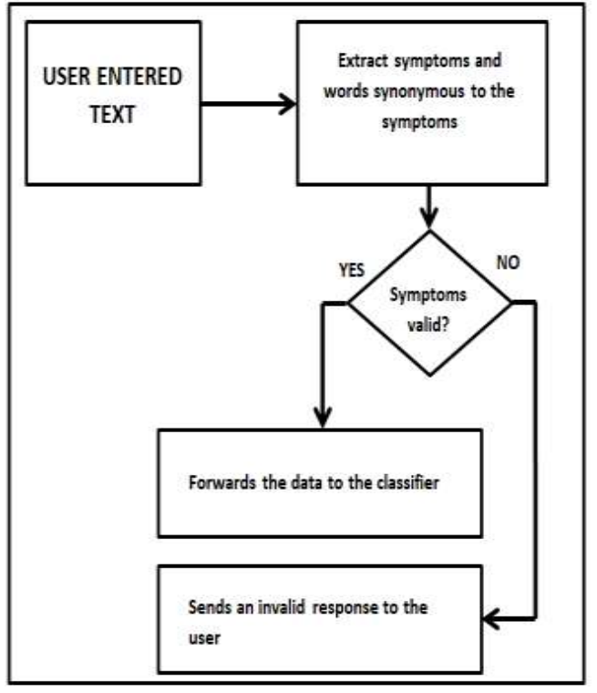
IDEA BRIEF
TF-IDF + KNN Approach for Disease Classification
This project explores the application of traditional machine learning methods for disease classification based on natural language symptom descriptions. The two key techniques used in this approach are:
TF-IDF (Term Frequency-Inverse Document Frequency): TF-IDF is used to convert the text data (symptom descriptions) into numerical features. It measures the importance of words within a document relative to a collection of documents, helping identify the most significant terms in the symptom descriptions.
K-Nearest Neighbors (KNN): KNN is a simple, instance-based learning algorithm. It classifies new symptom data based on the majority label of its K nearest neighbors in the feature space, which is formed by the TF-IDF vectors.
85-90% Accuracy: Limited in handling complex symptoms.
Transparent Decisions: Builds trust with healthcare professionals.
Easily Adaptable: Simple retraining for new diseases.

Slide 4
Literature Survey
Theme | Description | References / Insights
Traditional Diagnostic Systems | Relied heavily on structured data formats, rule-based decision trees, and manual feature engineering. Failed to interpret natural language inputs from patients. | Limited scalability and flexibility; often inaccurate when symptoms are vague or varied.
Need for NLP in Healthcare | Increasing patient use of free-text (natural language) symptom descriptions led to the adoption of NLP techniques for better understanding and automation. | NLP allows computers to read, extract, and analyze medical language inputs effectively.
TF-IDF (Term Frequency–Inverse Document Frequency) | A text vectorization method that assigns higher weights to rare but significant terms in patient input. Helps extract relevant features for disease classification. | Effective in emphasizing disease-specific keywords and reducing noise from common terms.

Slide 5
Theme | Description | References / Insights
Word Embeddings (e.g., Word2Vec, GloVe) | Dense vector representations of words that capture context and semantic similarity. Helps identify related symptoms expressed in different ways. | Useful for deep learning approaches but may require more computation and training data.
K-Nearest Neighbors (KNN) | A non-parametric, instance-based learning algorithm that classifies a new symptom vector based on the most common label among the k-nearest past cases. | Simple, interpretable, and performs well when combined with meaningful text representations like TF-IDF.
TF-IDF + KNN Combination | Studies show this combo yields high accuracy in disease prediction from text, especially for small or medium datasets with limited labeled data. | Ideal for real-world systems where fast, transparent predictions are needed.
Research Findings | Multiple works validate the use of TF-IDF and KNN for medical text classification tasks. This method is cost-effective, interpretable, and easy to deploy. | Well-suited for mobile apps or online tools for early disease screening.

Slide 6



Existing System
VS
Proposed System
Structured input (checkboxes, dropdowns, predefined symptom lists)
01
Free-text symptom input in natural language
Does not support natural language variations
02
Handles language richness using NLP techniques
Low scalable; difficult to adapt across varied populations and platforms
03
High Scalable; lightweight model suitable for mobile apps, chatbots, and telemedicine
Text processing not supported
05
Includes stopword removal, lemmatization, punctuation cleanup, and case normalization
Limited usability in resource-constrained or non-expert settings
Designed for broader accessibility and ease of deployment in real-world healthcare contexts
06
Rule-based technique, manual feature engineering.
07
Machine Learning- based (TF-IDF + KNN) technique.
Static or manually tuned
08
Uses Grid Search and Cross-validation for optimal performance

Slide 7







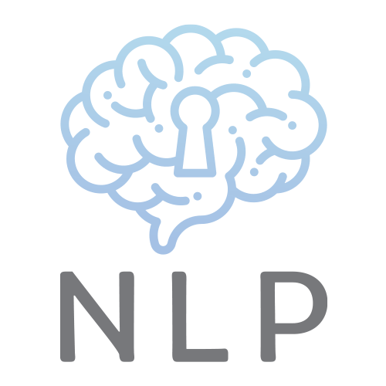
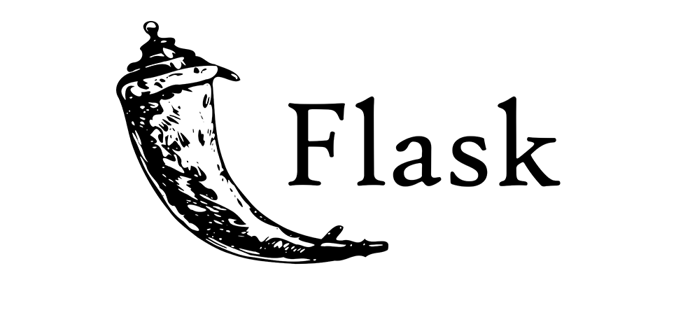

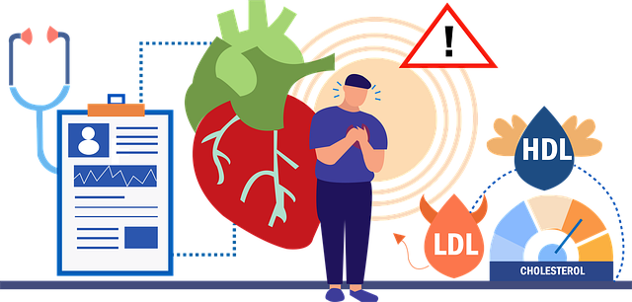


ARCHITECTURE
DIAGRAM
PYTHON & MACHINE LEARNING LIBRARIES
INPUT
(Symptoms)
Disease Prediction
TECH STACK

Slide 8
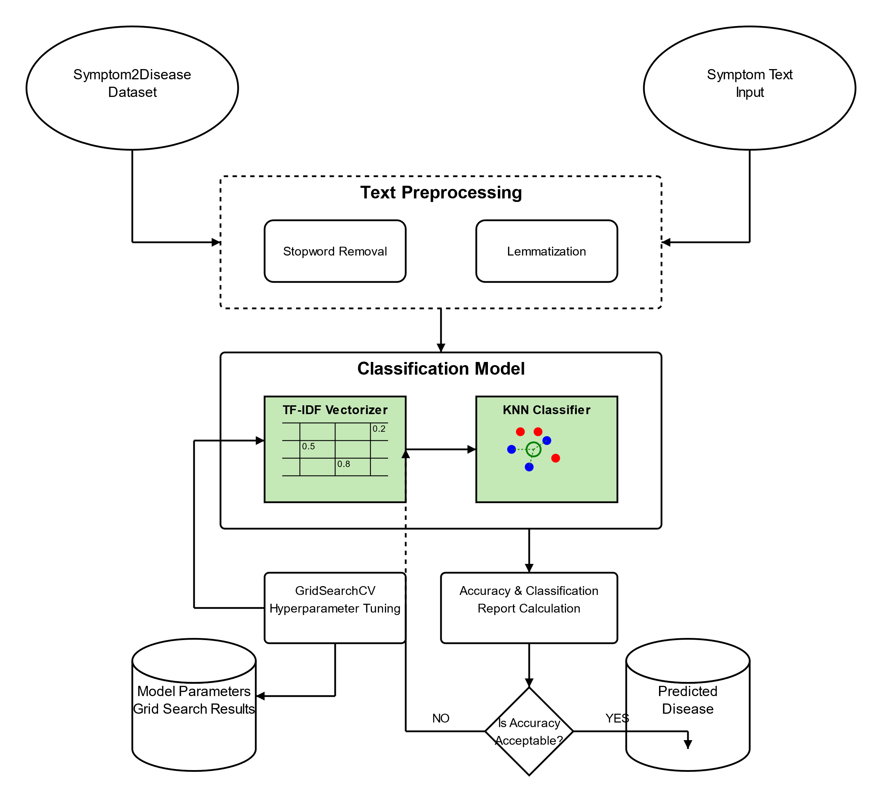
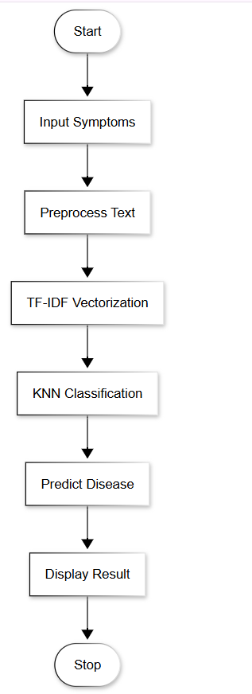
ARCHITECTURE DIAGRAM
SYSTEM FLOW DIAGRAM

Slide 9
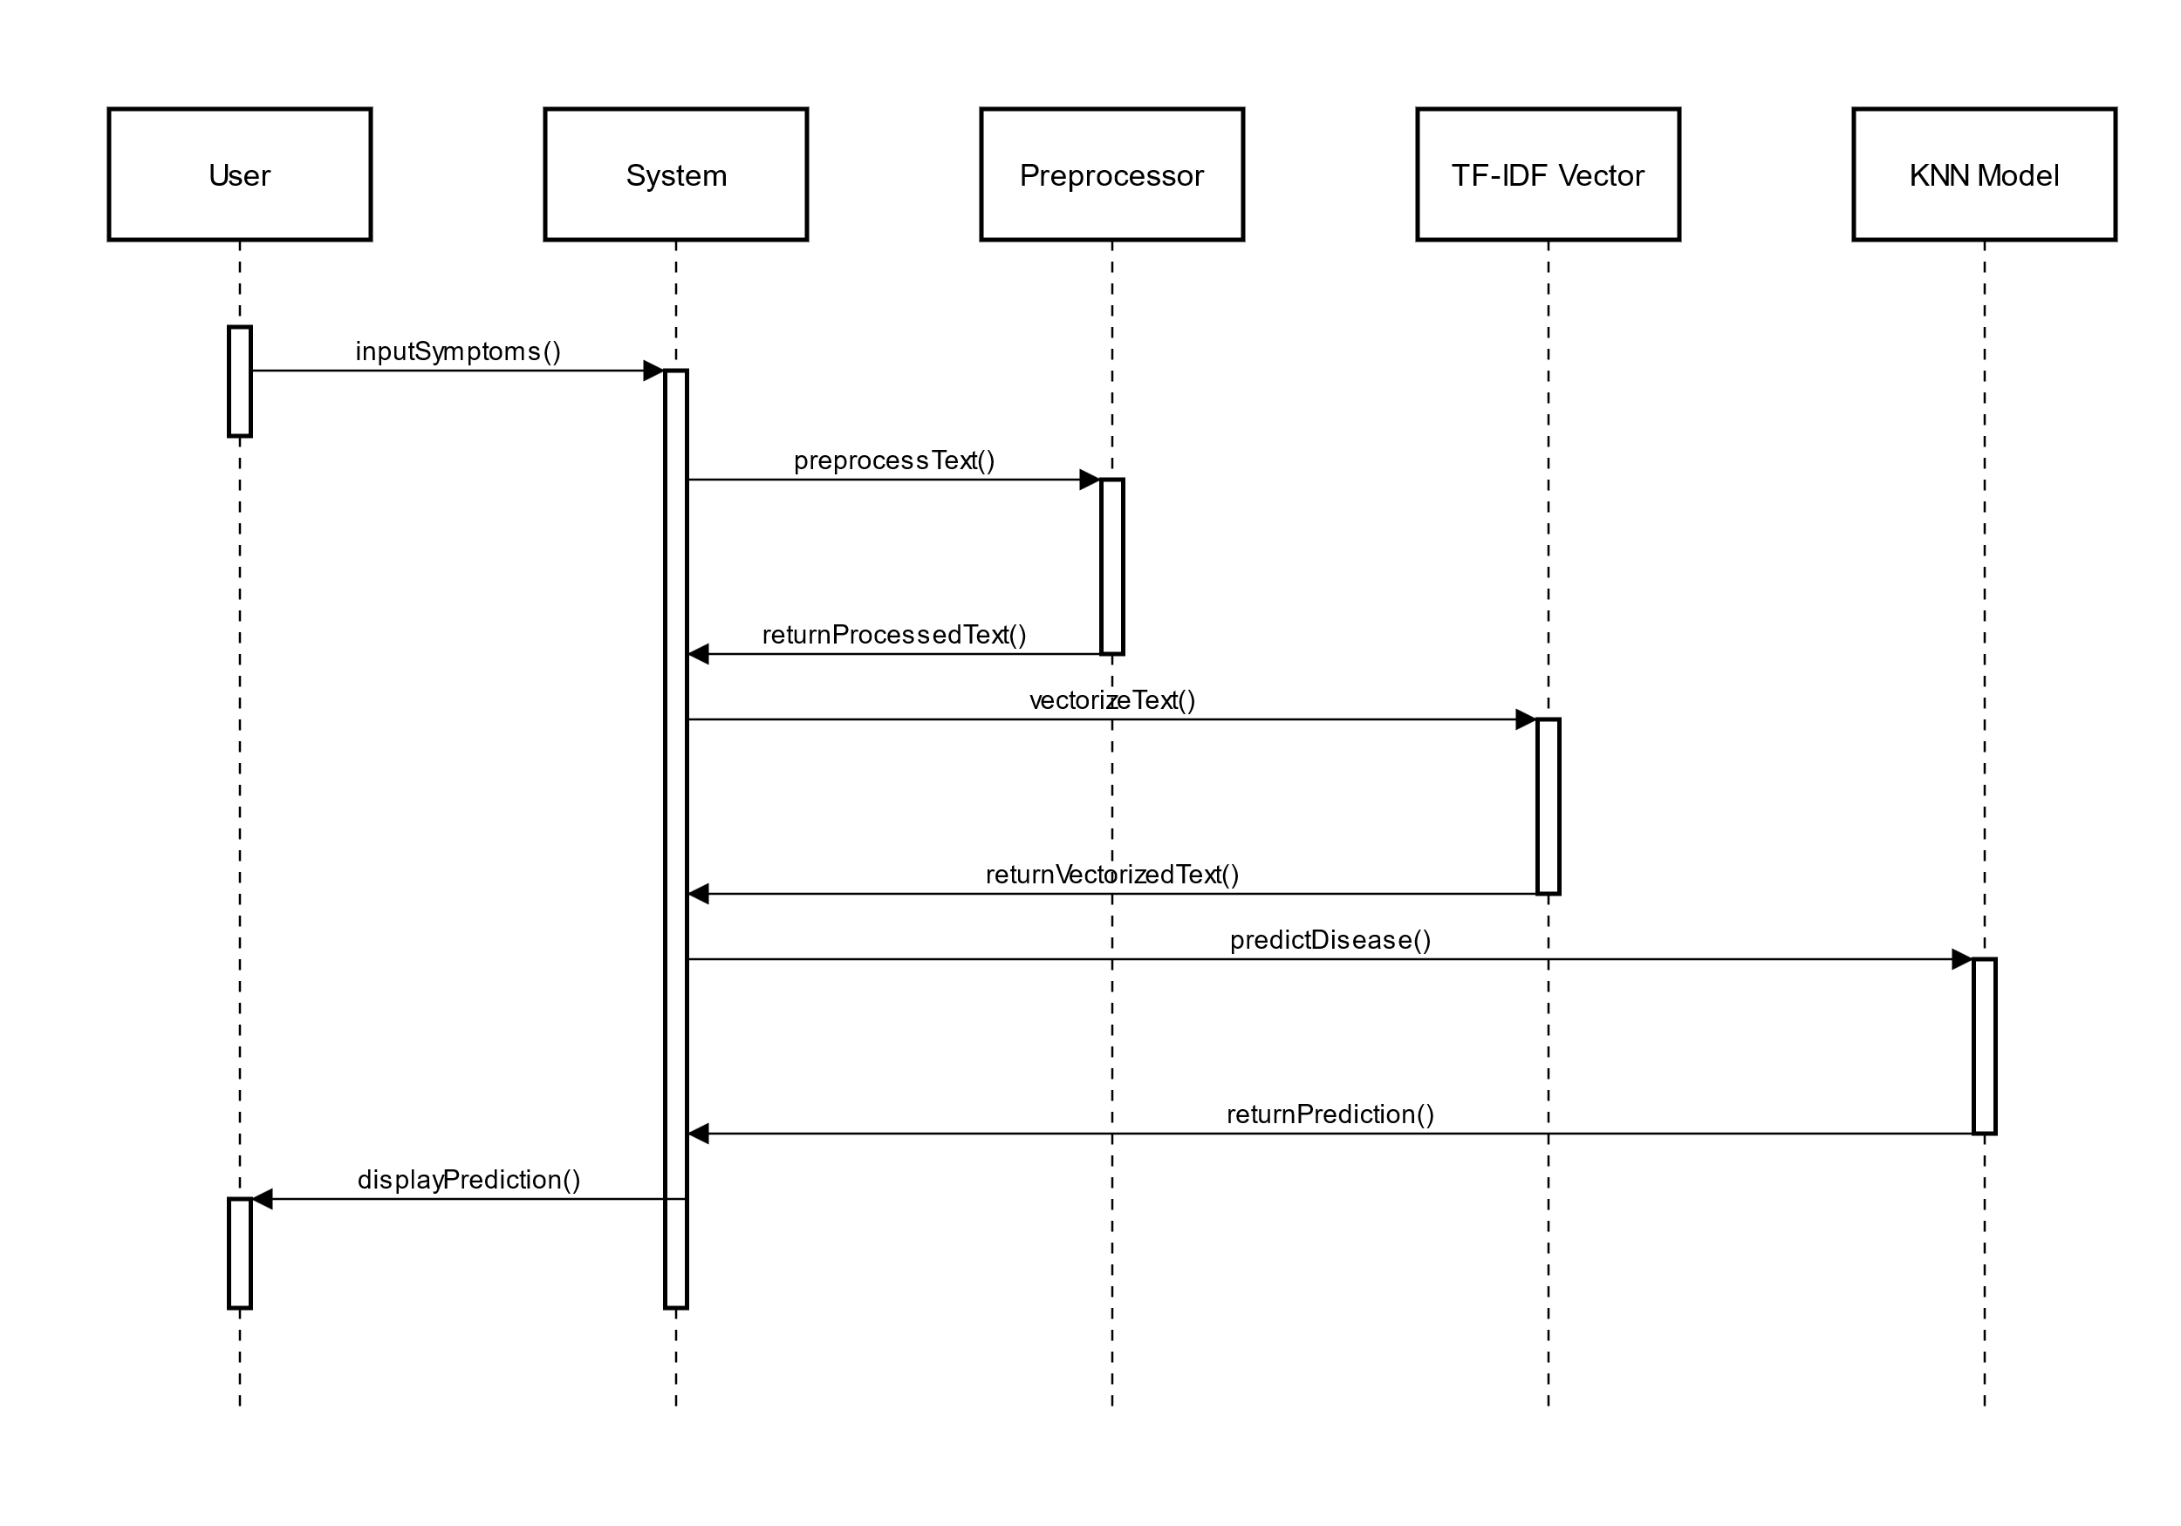
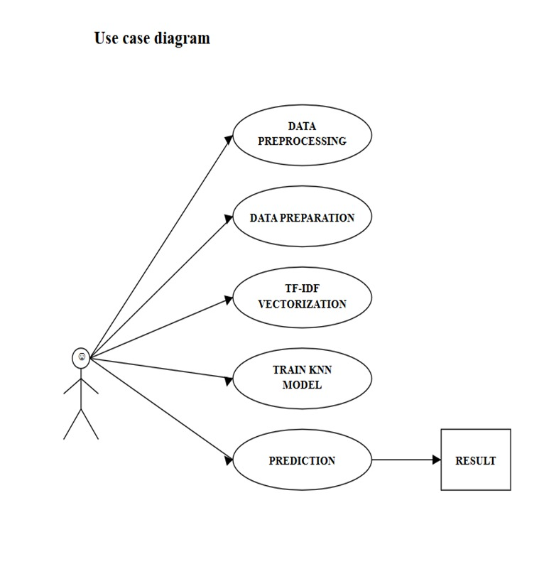
SEQUENCE DIAGRAM
USE CASE DIAGRAM

Slide 10
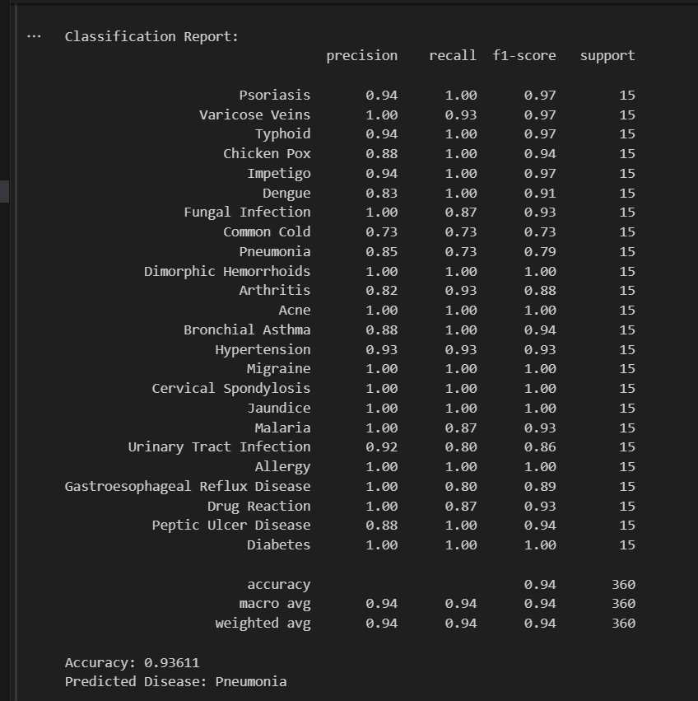
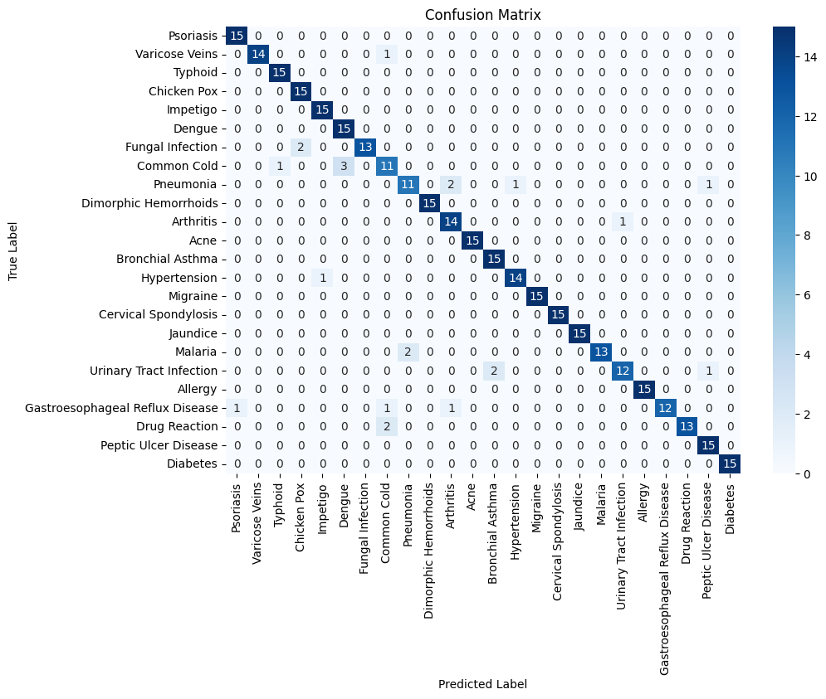
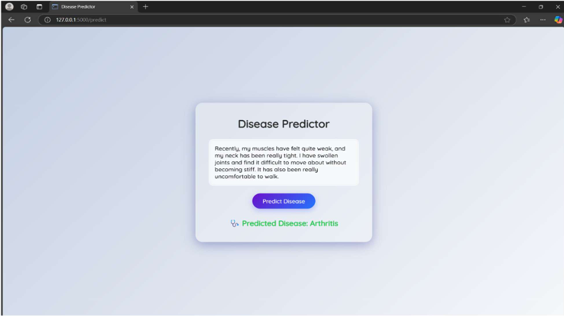
Results
KNN Confusion Matrix and Report

Slide 11


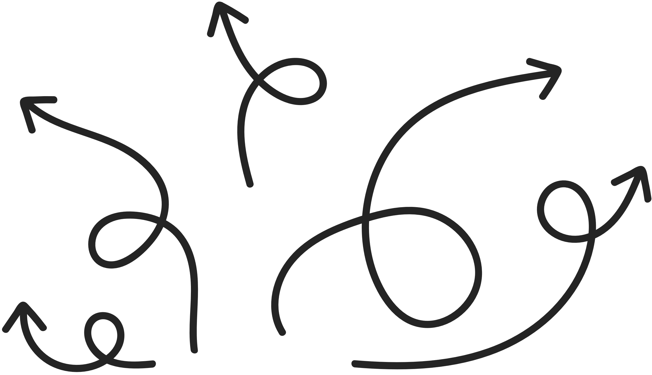





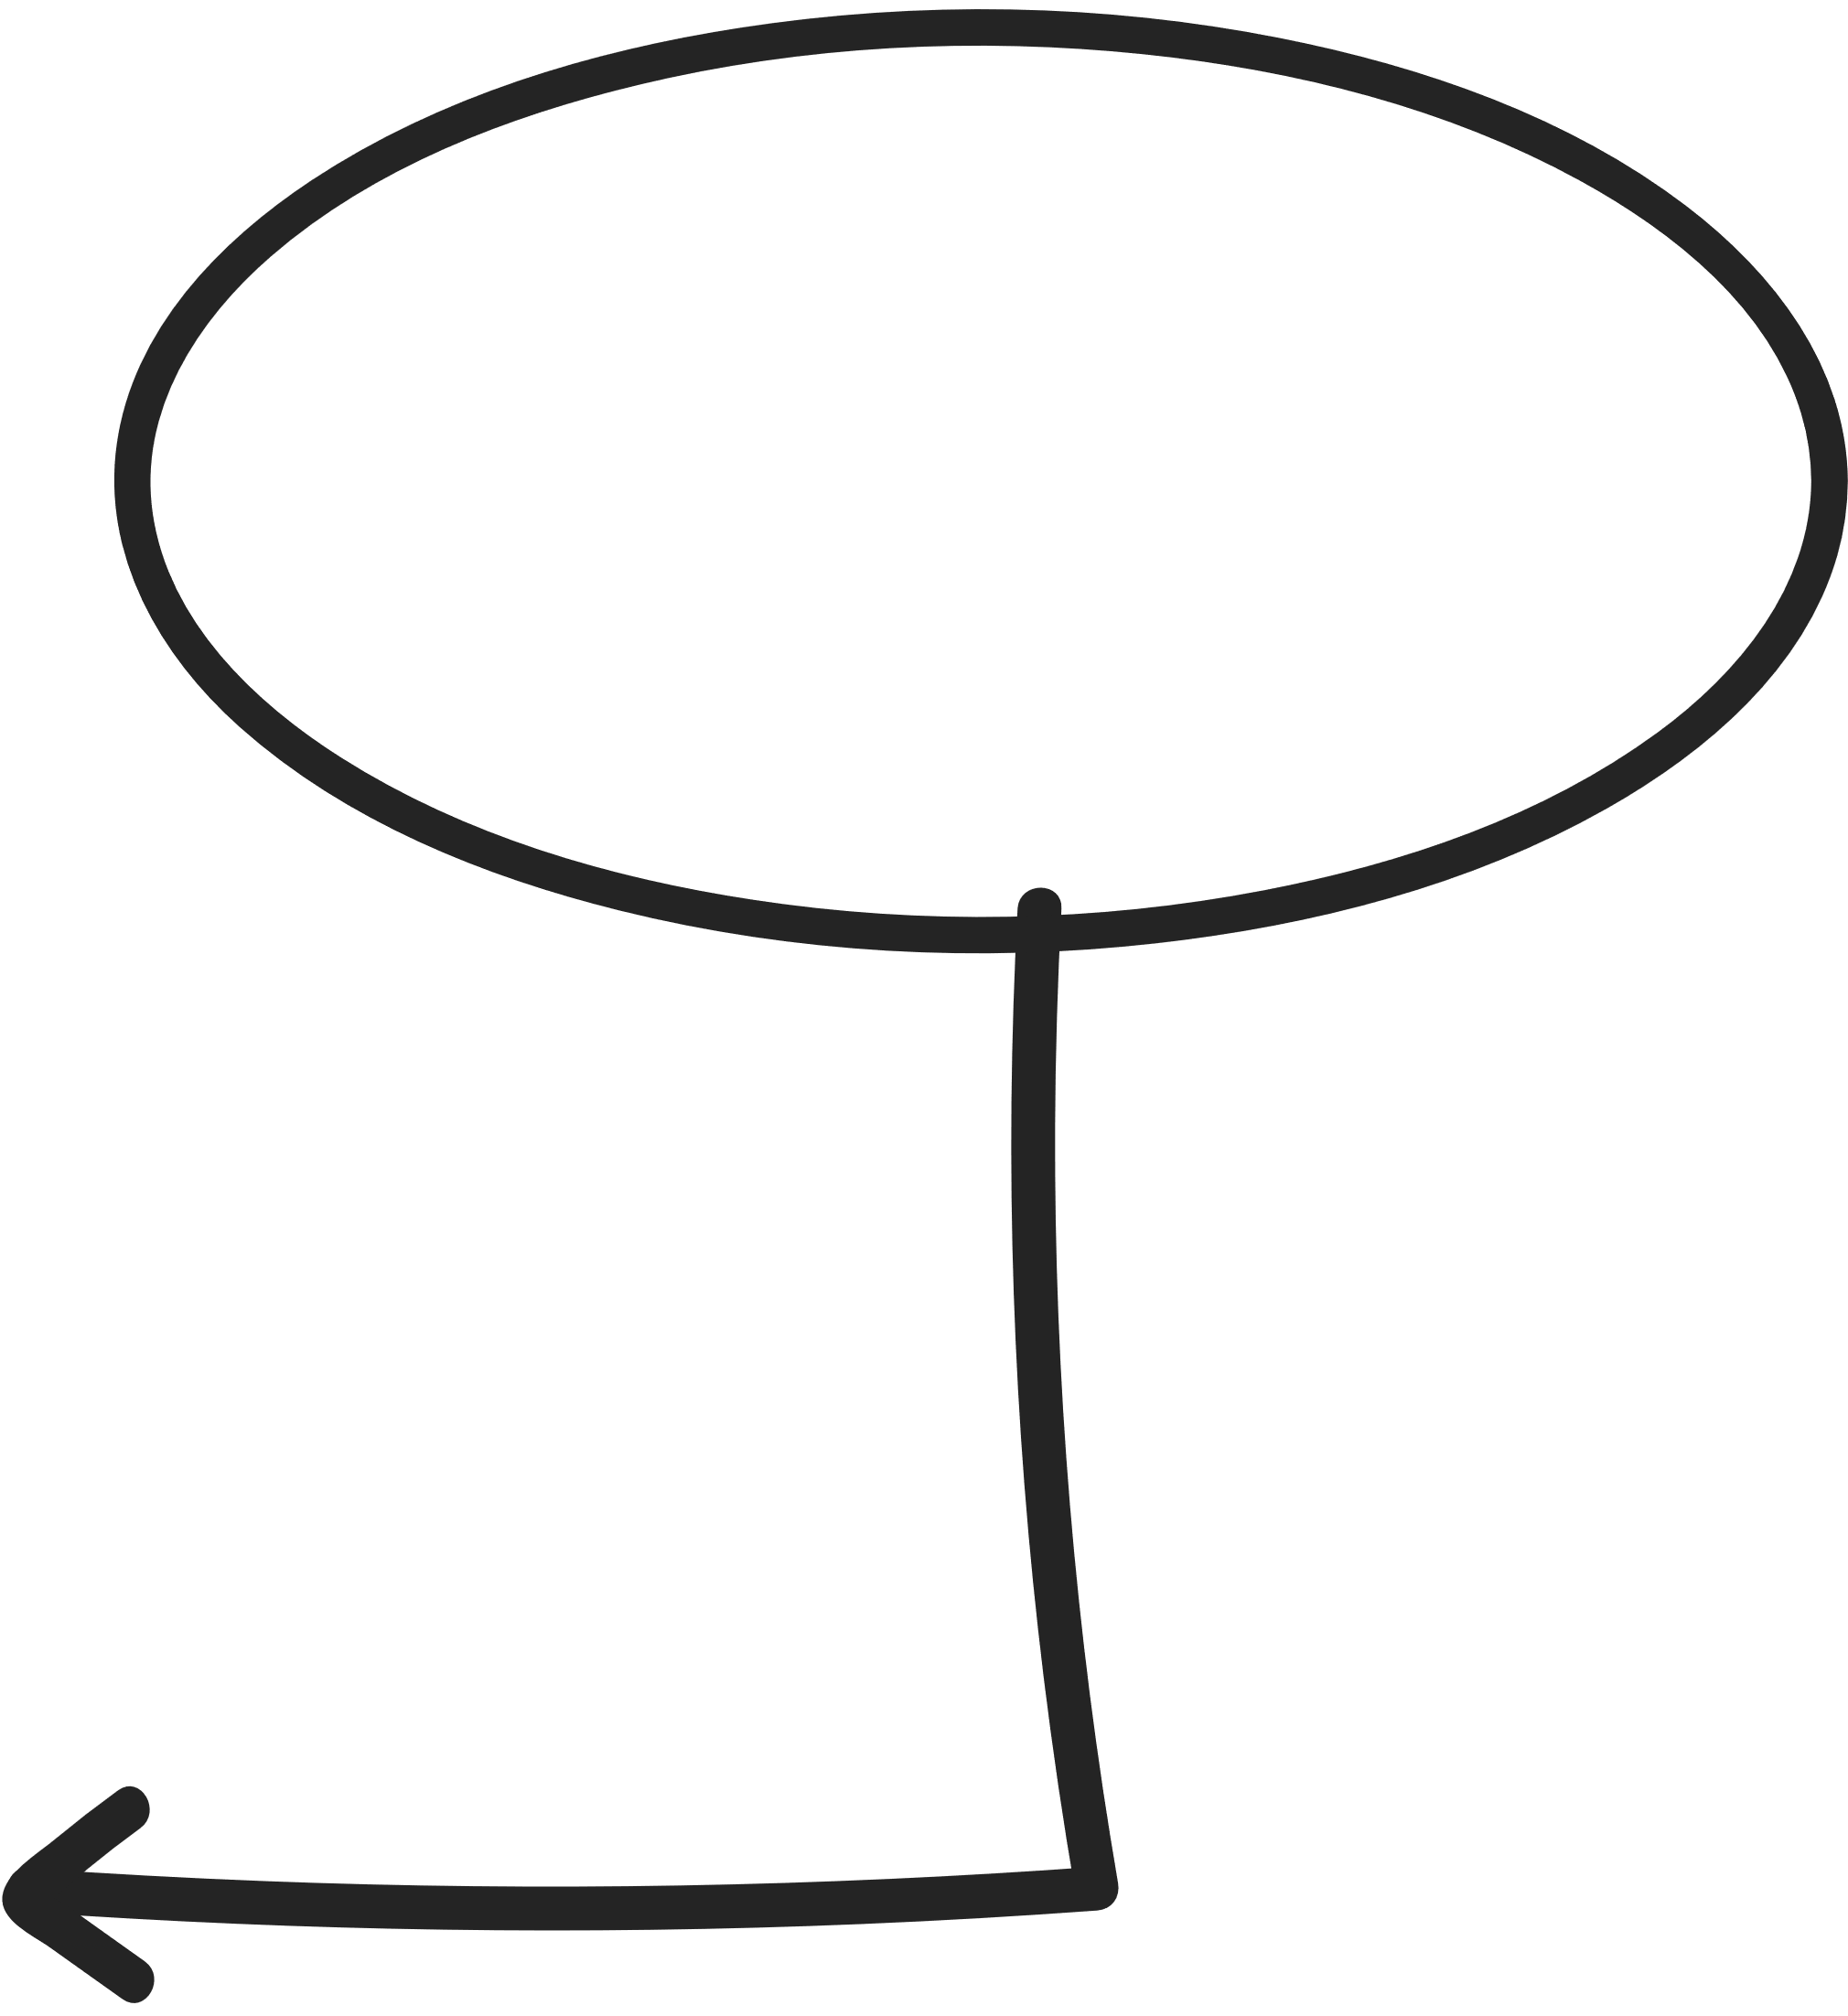


Incorporate voice and video input analysis
Support multi-label classification
For a more comprehensive and accessible diagnostic experience, especially for remote users or those with low literacy.
To predict multiple diseases from overlapping symptoms.
Integrate advanced word embeddings
Develop a user-friendly interface
FUTURE SCOPE
Integrate advanced word embeddings such as Word2Vec, GloVe, or BERT for deeper semantic understanding.
(chatbot/web/mobile app) for easy interaction.
Real-time
prediction integration
Expand the dataset
Multilingual support
Enable real-time prediction integration into telemedicine and virtual consultation platforms
Expand the dataset with real-world, diverse patient inputs to enhance accuracy and generalization.
Add multilingual support to serve a wider range of users.

Slide 12
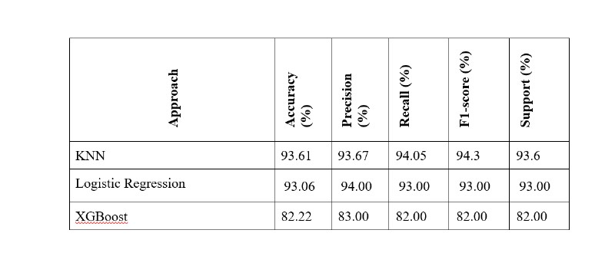
Conclusion
A machine learning-based system was developed using TF-IDF vectorization and K-Nearest Neighbors (KNN) for disease prediction from free-text symptom descriptions.
The model achieved a high accuracy of 93.61%, outperforming Logistic Regression (93.06%) and XGBoost (82.22%).
Text preprocessing (stopword removal, lemmatization, etc.) ensured clean input for effective vectorization.
Grid Search, cross-validation, and oversampling were used to optimize performance and address class imbalance.
KNN proved most effective due to its instance-based, interpretable nature, and strong alignment with TF-IDF features.
The system is lightweight and suitable for clinical triage, telemedicine, and low-resource environments.
Results Summary: KNN vs
Logistic Regression vs
XGBoost

Slide 13
References
Ramos, J. (2003). Using TF-IDF to Determine Word Relevance in Document Queries. Proceedings of the First Instructional Conference on Machine Learning.
Cover, T., & Hart, P. (1967). Nearest neighbor pattern classification. IEEE Transactions on Information Theory, 13(1), 21–27.
Gupta, D., & Khanna, A. (2017). A Study of Applications of Machine Learning in Healthcare. International Journal of Computer Applications, 162(8), 1–5.
Liu, L., Tang, L., Dong, W., Yao, S., & Zhou, W. (2016). An overview of topic modeling and its current applications in bioinformatics. SpringerPlus, 5(1), 1608.
Tiwari, R., & Pant, M. (2019). Disease Prediction System Based on Symptoms Using Machine Learning. Proceedings of the 2019 International Conference on Machine Learning, Big Data, Cloud and Parallel Computing (pp. 229–234). IEEE.
Mikolov, T., Sutskever, I., Chen, K., Corrado, G., & Dean, J. (2013). Distributed Representations of Words and Phrases and their Compositionality. Advances in Neural Information Processing Systems (NeurIPS).
Niyar Barman. (2022). Symptom to Disease Dataset. Kaggle Dataset

